Slide 1
Semantic Technology Brief Presented to: DAMA/National Capital Region
November 12, 2013

Slide 2
The Science Fiction Story We Like (Independence Day)
The alien ship is about to destroy the heroes (Will Smith and Jeff Goldblum).
Goldblum hacks into the alien computer.
He immediately and effortlessly understands and uses all the information in the alien computer.
He writes a simple program to use the all of the information in the alien computer.

Slide 3
The Science Fiction Movie Nobody Will Watch
Goldblum puts together a project plan to use data from an alien computer.
He spends weeks trying to understand the design of the alien database.
Then he spends months writing and testing a program to use the data.
He argues with the aliens over standard naming conventions for fields and variables.
His program finally works, but he is told the aliens want to release a new version of their database next week and, unfortunately, the changes will affect his program.

Slide 4
A True Story
I worked at an internet domain registration company that needed to update all of its business systems so that one account could have multiple registered domains—essentially a simple data modeling problem.
A new billing system was needed to accommodate the change, and also other business systems (CRM, Provisioning, web portal, etc) needed to be modified.
Each system interface was coded to use the data structure of every other system it touched.
After approximately 60 engineers spent 9 months retrofitting all of the other business systems, a delay with the new billing system caused the rollback of all the changes to all of the other systems.
These were systems built entirely upon data models. They contained data, not information.

Slide 5
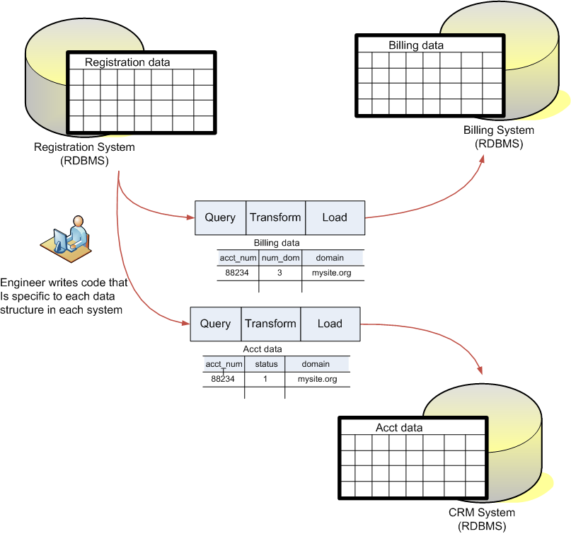
Traditional Approach

Slide 6
Drawbacks of this approach
Each system is directly affected by any change to other systems.
The meaning of the data is trapped inside its structure.
The data must be transformed into many different structures to be used.
Each business system has a distinct purpose and distinct structures.
Integrating new business units with redundant systems is extraordinarily complex and expensive.

Slide 7
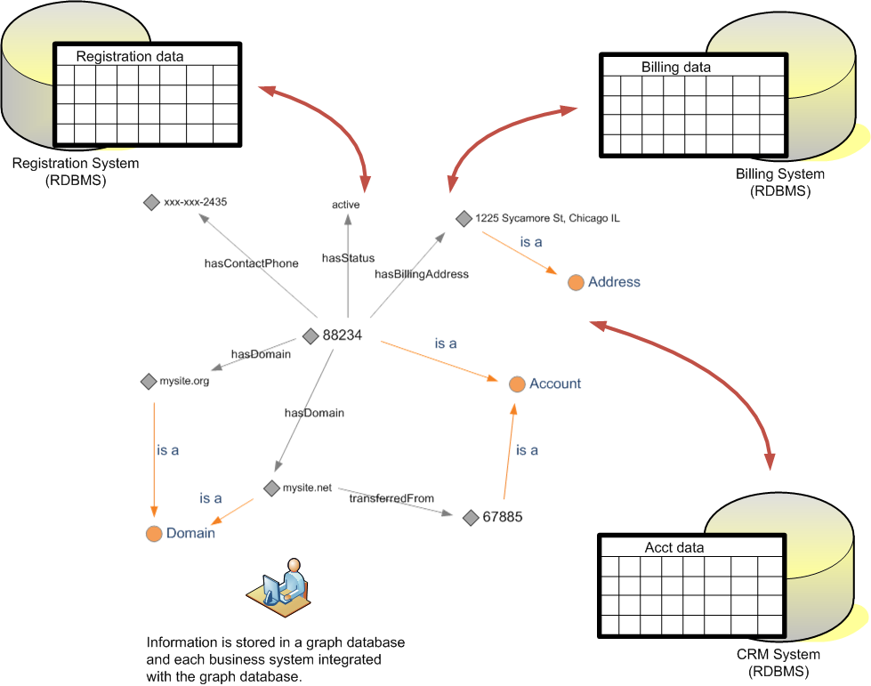
Semantic Approach

Slide 8
How is semantic technology different
Non-Semantic
Relationships are implicit in the structure.
Data must fit a pre-engineered structure.
Each structure is tightly coupled to a system problem.
You can not ask a question the structure does not support.
You cannot store a fact that the structure does not support.
Semantic
Relationships are explicit.
Information has no pre-engineered structure.
The information exists independently of any system problem.
You can ask any question.
You can store any fact.

Slide 9
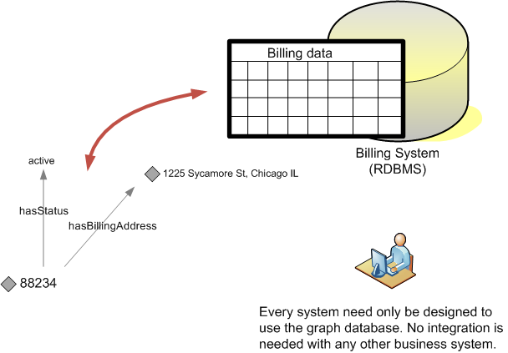
Integration with Semantic Technology

Slide 10
Benefits of Integration with Semantics
No business system is directly affected by changes to another system.
The meaning of the data is expressed in the data itself.
There is one enterprise model for information.
New business systems can be integrated without needing to understand any of the other business systems in the enterprise.
Can easily handle redundant systems that result from acquisition of new business units.

Slide 11
Integrated Data
Current integration efforts are based upon XML schemas—which are rigid and complex.
Getting agreement on the structure of data exchanged is difficult because structures are based upon individual system requirements and each system has unique needs and design.
Clients of integration endpoints must be coded specifically for each and every service they call.

Slide 12
How Semantics addresses data integration difficulties
Semantically based web services use a common vocabulary to describe data.
Client applications are not coded for a specific service. Data is encoded with a common vocabulary.
Semantic data has no predefined structure (no data model), so it is flexible.
Semantic data is “self-describing” so it is easier for engineers to understand what data really means.
Semantic data is based upon shared meanings that can be used by multiple entities, so it is far simpler than standard data models.

Slide 13
Where is Semantic Technology Used
Google, Yahoo, Facebook
Amdocs, Best Buy, JP Morgan Chase
CIA, NSA, DIA

Slide 14
Semantic Tools

Slide 15
Semantic Workbench

Slide 16
Semantic Workbench

Slide 17
semSQL and rules4J
semSQL uses SQL to create triples.
rules4J executes business rules
and transformation rules to build
graph data.

Slide 18
How semSQL semantically binds SQL

Slide 19
Integration and Information Discovery

Slide 20
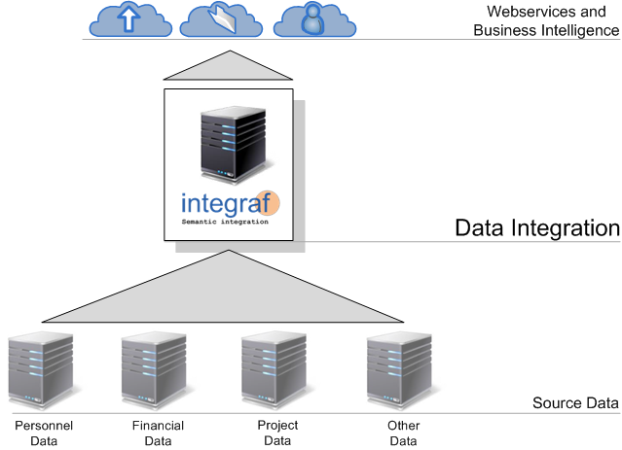
Integraf Overview

Slide 21
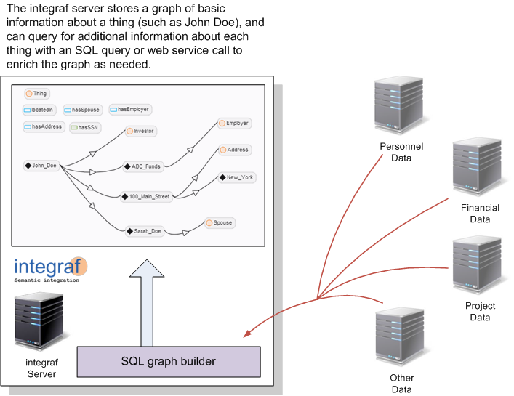
Data Aggregation

Slide 22
Under the Covers

Slide 23
Features
Rapid integration of XML and relational data in a data layer that indexes key entities in your enterprise data.
Each customer, event, partner, patient, company, etc in the data is represented by its own web page.
Transformation of data between industry standards.
Security model that is based upon meta data, the sensitivity of things, and the relationships between them.
Easily apply a security standard that spans data sources and that enforces consistent security between data sources.
"Googlesque" search and discovery of information in an enterprise is the starting point for building views of data.
Business intelligence with a common vocabulary.
Natural language tools for building common vocabulary.
Cloud scalable.
Integrates business rules with enterprise information

Slide 24
Questions
chris.a.moran@gmail.com
chris.moran@imsc.us

